Slide 1
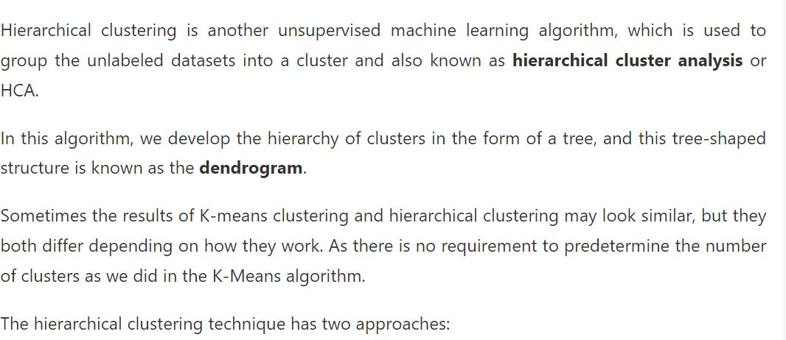

Slide 2
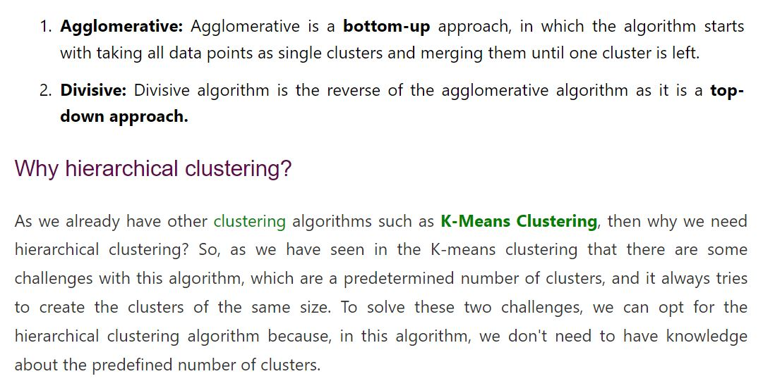

Slide 3
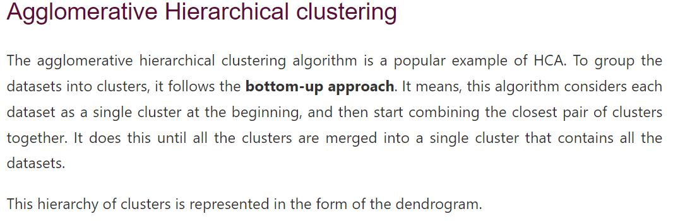

Slide 4
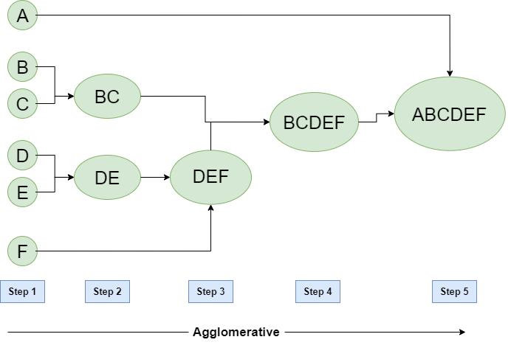

Slide 5
Hierarchical Divisive clustering
It is also known as a top-down approach. This algorithm also does not require to pre-specify the number of clusters. Top-down clustering requires a method for splitting a cluster that contains the whole data and proceeds by splitting clusters recursively until individual data have been split into singleton clusters.

Slide 6
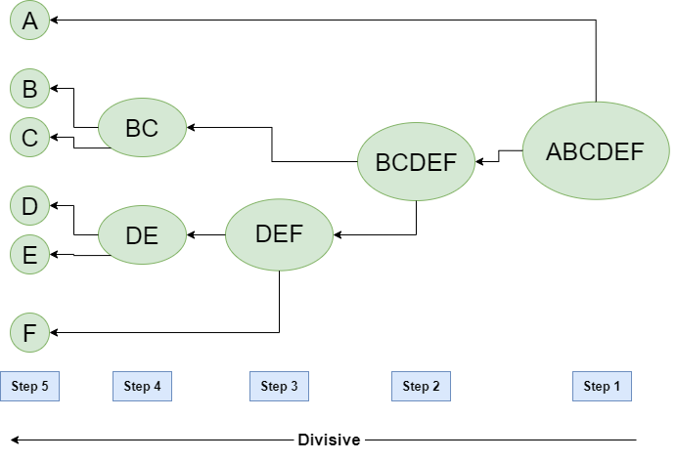

Slide 7
